Slide 1
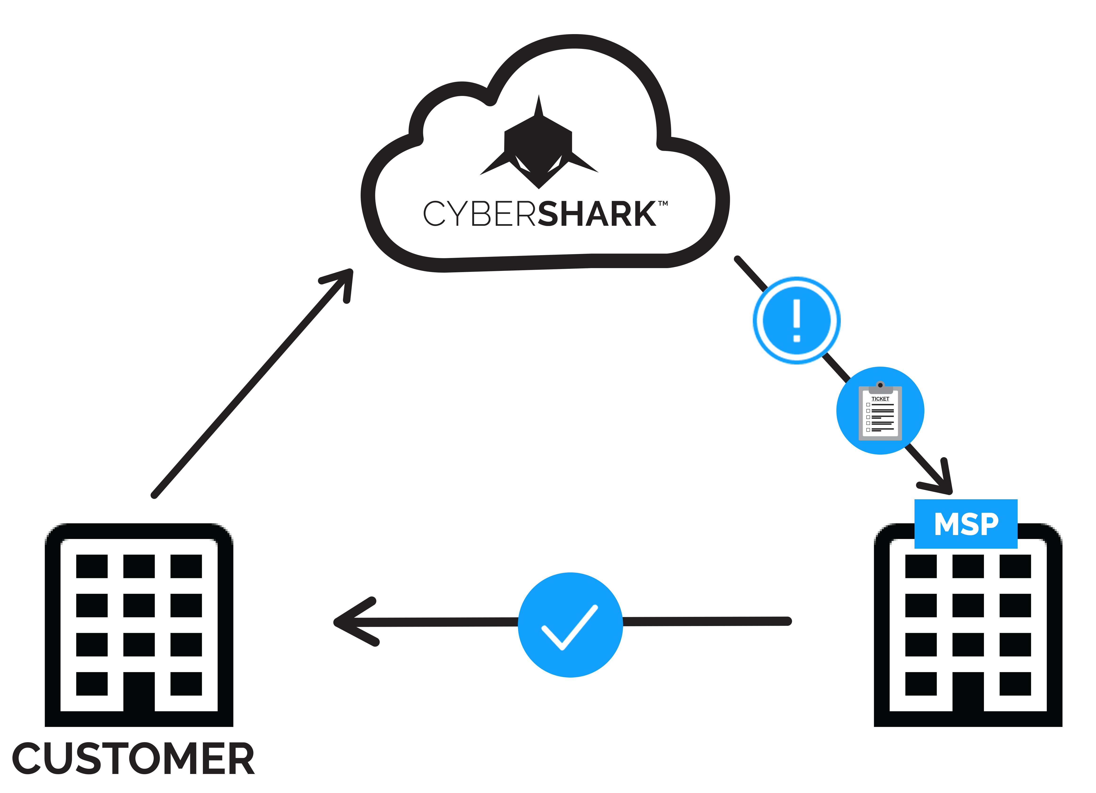
Increase Your Revenue with CYBERShark
Offer your customers enterprise-class security and compliance services at an affordable price
Is Your Customer’s Data and Business Safe from Cyber Attacks?
Do you think your customer’s business is too small to be targeted for cyber attacks? Think again. It’s not a matter of if, it’s a matter of when.
Employee and customer data, bank account and credit card information, intellectual property and trade secrets: These are just a few of the assets that most every business possesses — and that hackers find valuable. Without the right security measures in place, there is high risk that these assets will fall into the wrong hands.
White Label CYBERShark to Grow Your Business with Managed Security and Compliance Services
If you are a managed service provider serving small and mid-sized businesses, we have good news: You can now white label CYBERShark and offer your customers a comprehensive security and compliance service at an affordable monthly price.
Our solution provides advanced threat intelligence and the same level of security as the largest companies in the world. Data is protected in real-time and meets regulatory audit and reporting requirements. This includes providing specific compliance reports needed to pass HIPAA, PCI, FISMA and other audits.
CYBERShark is Comprised of:
A robust security and compliance platform, delivered as a service in the cloud
Monitoring performed by security experts at BlackStratus' Security Operations Center (SOC)
Guided remediation via trouble tickets – no in house security expertise needed
Security Made Easy
Early detection, expert insight and quick response
Real-time situational awareness to anticipate and rapidly respond to cyber threats
Enterprise class solution at a low affordable monthly cost
White Label CYBERShark to Grow Your Business and Protect Your Customer’s Data Today.
Comprehensive Security and Compliance at an Affordable Price.

Slide 2
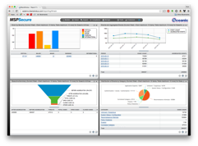
Demonstrate Value to Your Customers BEFORE Purchase
Offer a Free 30-day Trial that includes Health Assessment and Compliance Reporting
We will onboard up to 20 of their most crucial network devices
CYBERShark will monitor them and generate security & compliance reporting during the trial period
At the end of the trial, the customer gets a detailed assessment of the results
White Label CYBERShark and Provide Enterprise Class Security and Compliance Services on Day One
As an MSP, you can white label our service and build a sustainable security-as-a-service business without investing in expensive infrastructure, hardware appliances and security analysts. Provide your customers with advanced threat intelligence and the same level of security as the largest companies in the world, at a cost that meets even the most stringent budget.
We don’t just respond to security events, but continuously correlate system data looking for increasing levels of risk based on user activity to proactively stop breaches before they can occur. We provide 24/7 monitoring performed by security experts at the Security Operations Center (SOC) and actively monitor the thousands of bad websites, email scams and ransomware to ensure your employees are protected too. We also include our watchlist and Proofpoint commercial intelligence for highly accurate identification of known threats.
White label CYBERShark to help your customers:
Protect your data and your business
Minimize risk of breach
Respond to threats faster
Achieve compliance and avoid cost of failed audit
Reduce cost and time to repair
Dramatically cut costs
All for one low monthly cost and no long-term commitment.
Leverage the technology, people and process that you need to deliver an enterprise-class solution to your customers.
$400 billion
205 Days
95%
estimated global cost of cyber attacks annually*
*Inga Beale, CEO, Lloyd’s of London
average amount of time between breach and discovery*
*Verizon 2014 Data Breach Investigation Report (DBIR)
web attacks in 2015 carried out for financial gain*
*Verizon 2016 Data Breach Investigation Report (DBIR)
Ready to learn more?
Give us a call at 1 800-237-8931 ext. 71625 or email us cybershark@techdata.com

