Slide 1

Veritas Backup ExecTM
Presentation by <Product Marketing> | April 2020

Slide 2
How do you protect your data in the face of…
Increasing costs,
shrinking budgets
Rising threats
and regulations
Snowballing complexity
Evolving technology landscape
Notes:
All your infrastructure and applications touch or manipulate data in some way. But there’s lots of threats that can compromise systems and exploit your data.
And most regulations today prescribe how data should be stored and protected.
So how do you protect your data in the face of –
Rising costs and shrinking budgets
Security and compliance in a digital first world
Snowballing IT complexity
And an Evolving technology landscape

Slide 3

Rising threats and regulations
Increasing costs,
shrinking budgets
“The costs of deploying, maintaining and
upgrading architectures
are unpredictable.”
175ZB
$40M
“I’m not confident I can recover from a ransomware attack.”
of data by 2025
Lost in March 2019
by an aluminium manufacturer
Notes:
Data continues to grow but IT budgets are not growing. The latest prediction from IDC is that by 2025, there will be 175 zettabytes of data world wide. So with shrinking budgets how do you manage and protect growing data architectures?

Slide 4

Security and compliance
Rising threats and regulations
Increasing costs,
shrinking budgets
“The costs of deploying, maintaining and
upgrading architectures
are unpredictable.”
Dark data exceeds
“I’m not confident that I’m fully compliant with all the regulations in my industry.”
$40M
50%
175ZB
“I’m not confident I can recover from a ransomware attack.”
Lost in March 2019
by an aluminium manufacturer
creating major security
blinds spots for
most companies
of data by 2025
Notes:
There are many threats that can exploit business applications and data. Ransomware is just one of these threats. During a single week in March of this year, a string of ransomware called “LockerGoga” collapsed systems of one of the worlds largest aluminum manufacturers, costing them $40 million USD.
Ransomware is a serious threat. And there are so many types. These attacks evolve and are becoming more and more sophisticated. Indeed, it’s no longer about if, but when an attack will occur. And more importantly, how quickly organizations can recover their data and business applications from such an attack.
Source: https://www.helpnetsecurity.com/2019/03/27/norsk-hydro-ransomware-losses/

Slide 5
Snowballing complexity
Rising threats and regulations
Security and compliance
Dark data exceeds
40%
“It’s difficult to manage, control and report on
non-integrated components across my infrastructure.”
“I’m not confident that I’m fully compliant with all the regulations in my industry.”
50%
$40M
“I’m not confident I can recover from a ransomware attack.”
of IT decision makers and
data managers say there
are too many different
data management
tools/systems in use
creating major security
blinds spots for
most companies
Lost in March 2019
by an aluminium manufacturer
Notes:
THIS IS AN OPTIONAL SLIDE TO EITHER INCLUDE OR NOT DEPENDING ON YOUR SPECIFC CUSTOMER CHALLENGES
There exist many threats to organizations data and business applications.
Consider just a single form of threat enterprises are dealing with currently: ransomware.
During a single week in March of this year, a particular string of ransomware now known as “LockerGoga” collapsed the operational systems of one of the worlds largest aluminum manufacturers costing them $40 million USD so far.
Source: https://www.helpnetsecurity.com/2019/03/27/norsk-hydro-ransomware-losses/
Ransomware is a serious threat. And there are so many types. These attacks evolve and are becoming more and more sophisticated.
Indeed, it’s no longer about if, but when an attack will occur.
And more importantly, how quickly organizations can recover their data and business applications from such an attack.

Slide 6
Snowballing complexity
Snowballing complexity
Security and compliance
“I don't have an easy way
to protect all of my data fragmented across
on-premise, physical,
virtual & cloud.”
“It’s difficult to manage, control and report on
non-integrated components across my infrastructure.”
40%
Dark data exceeds
“I’m not confident that I’m fully compliant with all the regulations in my industry.”
58%
50%
of IT decision makers and
data managers say there
are too many different
data management
tools/systems in use
say complexity limits their ability
to realize data value
creating major security
blinds spots for
most companies
Notes:
THIS IS AN OPTIONAL SLIDE TO EITHER INCLUDE OR NOT DEPENDING ON YOUR SPECIFC CUSTOMER CHALLENGES
One of the most common things standing in the way of accomplishing data-driven goals for any organizations is complexity.
Managing data growth, dealing with threats, and complying with existing and yet-to-be-drafted regulation is already hard to do.
It’s getting even harder to do at scale, and come organizations can’t do it at all because the complexity has inundated them.
Unlike in our personal lives, where we do complete overhauls of our technology every so often (yearly in some cases) like in the case of our smart phones or PCs, the IT environment our customers are dealing with continues to get more and more complex because each new generation of IT simply gets integrated with the previous.
Mainframes still exist alongside, client-servers, alongside virtual machines, alongside clouds, alongside containers, alongside server-less…they all continue to exist and make up today’s heterogeneous IT environment.
Managing, controlling and reporting on non-integrated components across your infrastructure is hard. (this is referring to organizations using different point tools across their environment)

Slide 7
Snowballing complexity
Snowballing complexity
Rising threats and regulations
Evolving technology
landscape
“I don't have an easy way
of protecting all my data fragmented across
on-premise, physical,
virtual & cloud.”
40%
“It’s difficult to manage, control and report on
non-integrated components across my infrastructure.”
“I can’t protect new technologies with my
current solution.”
$40M
58%
75%
“I’m not confident I can recover from a ransomware attack.”
of IT decision makers and
data managers say there
are too many different
data management
tools/systems in use
say complexity limits their ability
to realize data value
Lost in March 2019
by an aluminium manufacturer
will adopt hybrid or multi-cloud environments by 2020
Notes:
One of the most common things standing in the way of becoming data-driven is IT complexity. As organizations expand and their IT footprints grow, protecting data with different point tools becomes really hard. 58% of organizations say that the complexity of their data footprint limits their ability to realize data value.

Slide 8
Snowballing complexity
Evolving technology
landscape
“I don't have an easy way
to protect all of my data fragmented across
on-premise, physical,
virtual & cloud.”
“I can’t protect new technologies with my
current solution.”
75%
58%
will adopt hybrid or multi-cloud environments by 2020
say complexity limits their ability
to realize data value
Notes:
Which brings me to evolving technology landscapes. Cloud is top of mind for almost all CEOs. According to Gartner, 75% of organizations will have deployed hybrid cloud or multi cloud models by 2020. Because of this, organizations are facing challenges protecting new technologies with old solutions.

Slide 9
You need to…
So how do you protect your data in the face of…
Rising threats
and regulations
Snowballing complexity
Evolving technology landscape
Increasing costs,
shrinking budgets
Manage
Business Risks
Trust that
“It Just Works”
Prepare for
the Future
Reduce Cost
and Complexity
Notes:
So that begs the question then, how in this complex IT landscape can you manage MORE data with LESS budget?
Or protect data and business applications against MORE threats that would steal it, exploit it, or expose it?
Or navigate a regulatory environment with many MORE laws to deal with today and in to the future?
Or adopt new technologies while reducing complexity?
You need a way to protect your critical data that also helps you =
Reduce Cost and Complexity
Manage Business Risks
Trust that It Just works!
Prepare for the Future

Slide 10
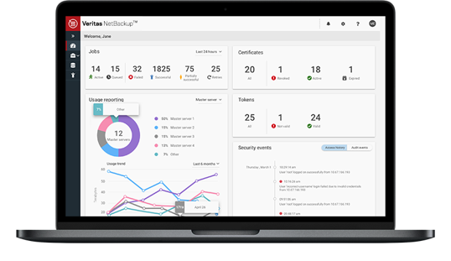
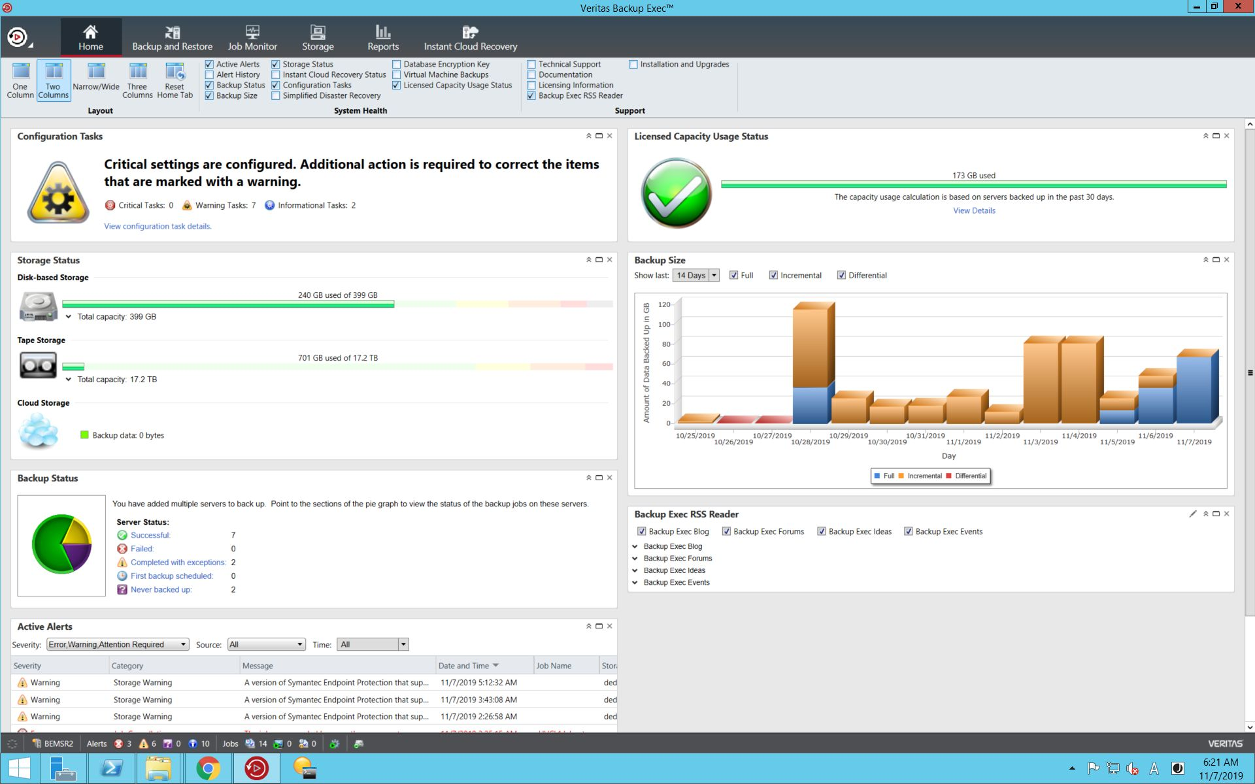
Veritas Backup ExecTM
Simple
Secure
Unified
Notes:
I’d like to introduce Veritas Backup Exec. We have a history of innovation through every major data center transformation.

Slide 11

Backup Exec reduces cost and complexity
Lower Software
Maintenance
Streamline
Management
Flexible licensing
Lower TCO
Eliminate point products
Single console
Minimize
Infrastructure CapEx
Intelligent deduplication
Superior scalability
High performance cloud dedupe
Flexible storage targets
Backup Exec reduces TCO by up to 50%

Slide 12

Habitat for Humanity
GOAL:
Replace legacy data protection solution with a unified, reliable, backup and recovery solution to prevent data loss
RESULTS:
No staff required to oversee backups day-to-day
High data availability
Data protected even in a disaster as backup data resides in cloud
Increased performance, reliability, and ease of use
Notes:
https://www.veritas.com/customer-success/skagit-habitat
Customer Success video: https://www.youtube.com/watch?v=8frVYSQfcZs&feature=emb_logo

Slide 13
Backup Exec helps you manage business risks
Zero
Downtime
No data loss
Orchestrated application recovery
Non-disruptive recovery rehearsals
Off-site replication
Instant Cloud Recovery
Instant Recovery of VMs
Secure
Against Threats
Meet Compliance Regulations
Ransomware Resilience
Two-factor Authentication
GDPR Guard
Backup visibility and compliance
Assured recovery from ransomware

Slide 14
Backup Exec prepares you for the future
Virtual Environments and Modern Workloads
Integrated Reporting
Automated discovery
Forever Incremental Backups
Granular Recovery
Instant Recovery
Smart Meter Integration
SaaS Backup Integration
Cloud
Adoption
SaaS Workload Protection
Backup to and from the cloud
Cloud disaster recovery
Archive to cloud
SaaS Backup Reporting integration
Office 365, G-Suite, Salesforce workload protection
Live on the edge! We’ve got your back

Slide 15
Deploy any way you want
Software
Virtual Image
Physical Hardware
Cloud
SaaS

Slide 16
10 reasons Backup Exec is the data protection leader for Mid-market and SMB
1
SIMPLICITY
Deploy unified data protection using a single, easy-to-use interface, intelligent dashboards and intuitive wizards
2
MODERNIZE
Transition to cloud confidently—Backup Exec supports all major Cloud Service Providers
3
TCO
Achieve 50% average cost savings by eliminating point products and single efficient
dedupe store
4
scale
Grow VM deployments endlessly with Backup Exec Accelerator, that provides forever incremental VM backups, reducing backup windows
5
Reliability
Easily recover your data in a few simple clicks, thanks to features like Ransomware Resilience, Instant Recovery of VMs, and Instant Cloud Recovery
6
SECURE
Ransomware Resilience protects your backup server and backup data. 2-Factor Authentication guards the access of the Backup Exec console
7
COMPLIANT
Make sure your data is compliant—Backup Exec GDPR Guard has your back
8
virtual
Backup Exec provides enhanced virtual environment protection capabilities, improving performance by up to 50%
9
Cloud
Instant Cloud Recovery integrates with Azure Site Recovery to provide a DRaaS solution, keeping your data available at all times.
10
flexibility
You can back up to virtually any storage device including disk, tape, dedupe storage, appliance, private, public and even multi-cloud.
Notes:
Backup Exec is more than just a backup product. It is a platform upon which a variety of data management capabilities can be built upon, providing data visibility, resilience, and copy management.
Backup Exec eliminates point products, can be deployed in any from, enables the latest technologies, and simplifies everything
Above all – Backup Exec abstracts all the complexity behind your data, so you can be assured your data is protected and realize the most value for your business to succeed.

Slide 17
Why Backup Exec is the data protection leader for Mid-market and SMB
SIMPLICITY
FLEXIBILITY
Reliability
Unified Data Protection
Easy to use, single console
No multiple point products
Full visibility and reporting
Confidently transition to cloud
Endlessly scale VM deployments
Minimize backup windows
Integration with all major clouds
Instant recovery of data
Data Compliance tool
Ransomware protection
DRaaS in cloud
Notes:
Backup Exec is more than just a backup product. It is a platform upon which a variety of data management capabilities can be built upon, providing data visibility, resilience, and copy management.
Backup Exec eliminates point products, can be deployed in any from, enables the latest technologies, and simplifies everything
Above all – Backup Exec abstracts all the complexity behind your data, so you can be assured your data is protected and realize the most value for your business to succeed.

Slide 18
Our latest innovations
Notes:
So what’s new in Backup Exec 20.6?

Slide 19
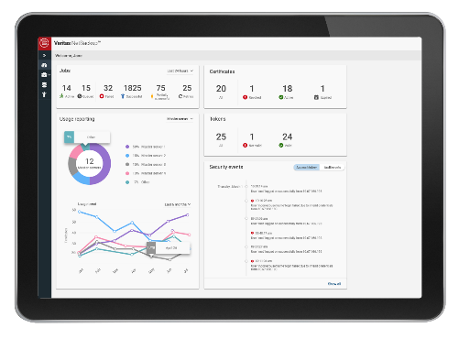
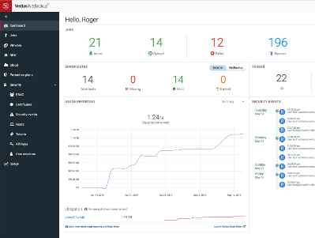
Backup Exec New Key Features
Backup Exec Accelerator—forever incremental VM backups
VSphere 7 support
Ransomware Resilience – additional protection to backup storage and processes
2-Factor Authentication – additional protection to secure the Backup Exec console
GDPR Guard – Prevent restoration of sensitive data without permission
Call Home - Automatic license updates

Slide 20


Backup Exec takes virtual to the next level
Extended hyperconverged environment support
Forever incremental backups
Instant Recovery of VMs
Granular Recovery Technology
Change Block Tracking
Recovery Ready for VMs

Slide 21




Backup Exec supercharges the cloud
In-line deduplication to the cloud
Support for all AWS S3 storage targets
Disaster recovery to & in the cloud
Cloud-native data protection

Slide 22
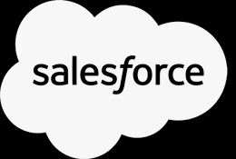



SaaS workload protection
SaaS Backup
Access SaaS Backup directly from your Backup Exec dashboard
Protect your SaaS workloads, including Office 365, Dynamics 365, Salesforce and G-Suite
Office 365 provides limited data protection
→Doesn’t make a second copy of your data
→No protection against Ransomware
→Data retention policies are insufficient
→Litigation hold is not a practical backup
→Limited restores
Notes:
Mention there is a misconception about SaaS workload data protection: Microsoft is not responsible for Data Classification and offers very limited Data protection capabilities.

Slide 23
Reduce Cost
and Complexity
Manage
Business Risks
Trust that
“It Just Works”
Prepare for
the Future
Always protected data. Confident recoverability.
Notes:
Starting over is a non-option. Standardizing on a platform is the only path forward. But not just any platform. Chose Veritas Backup Exec for effective protection and quick recovery. We deliver!

Slide 24
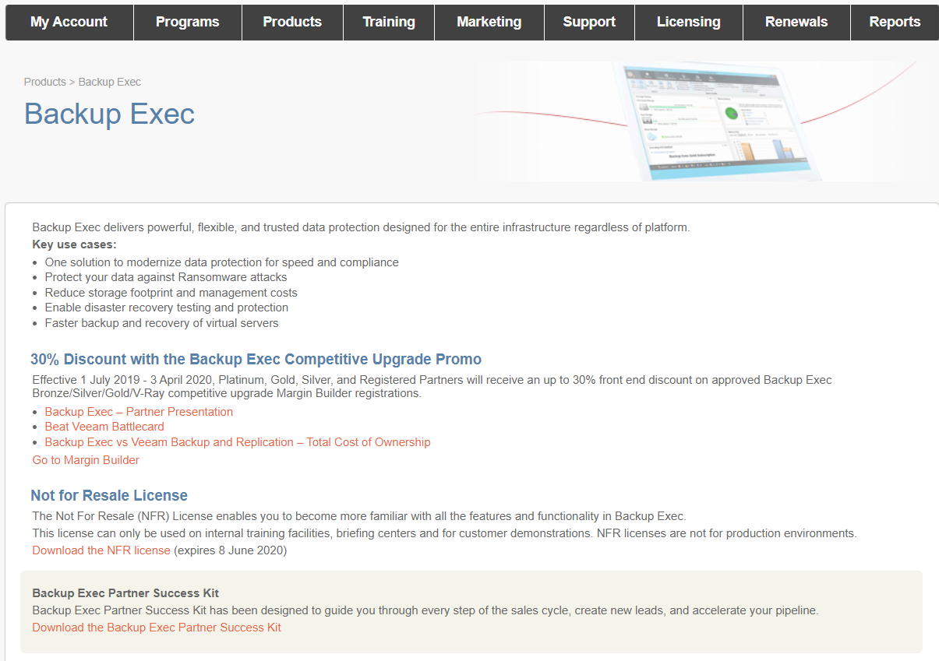
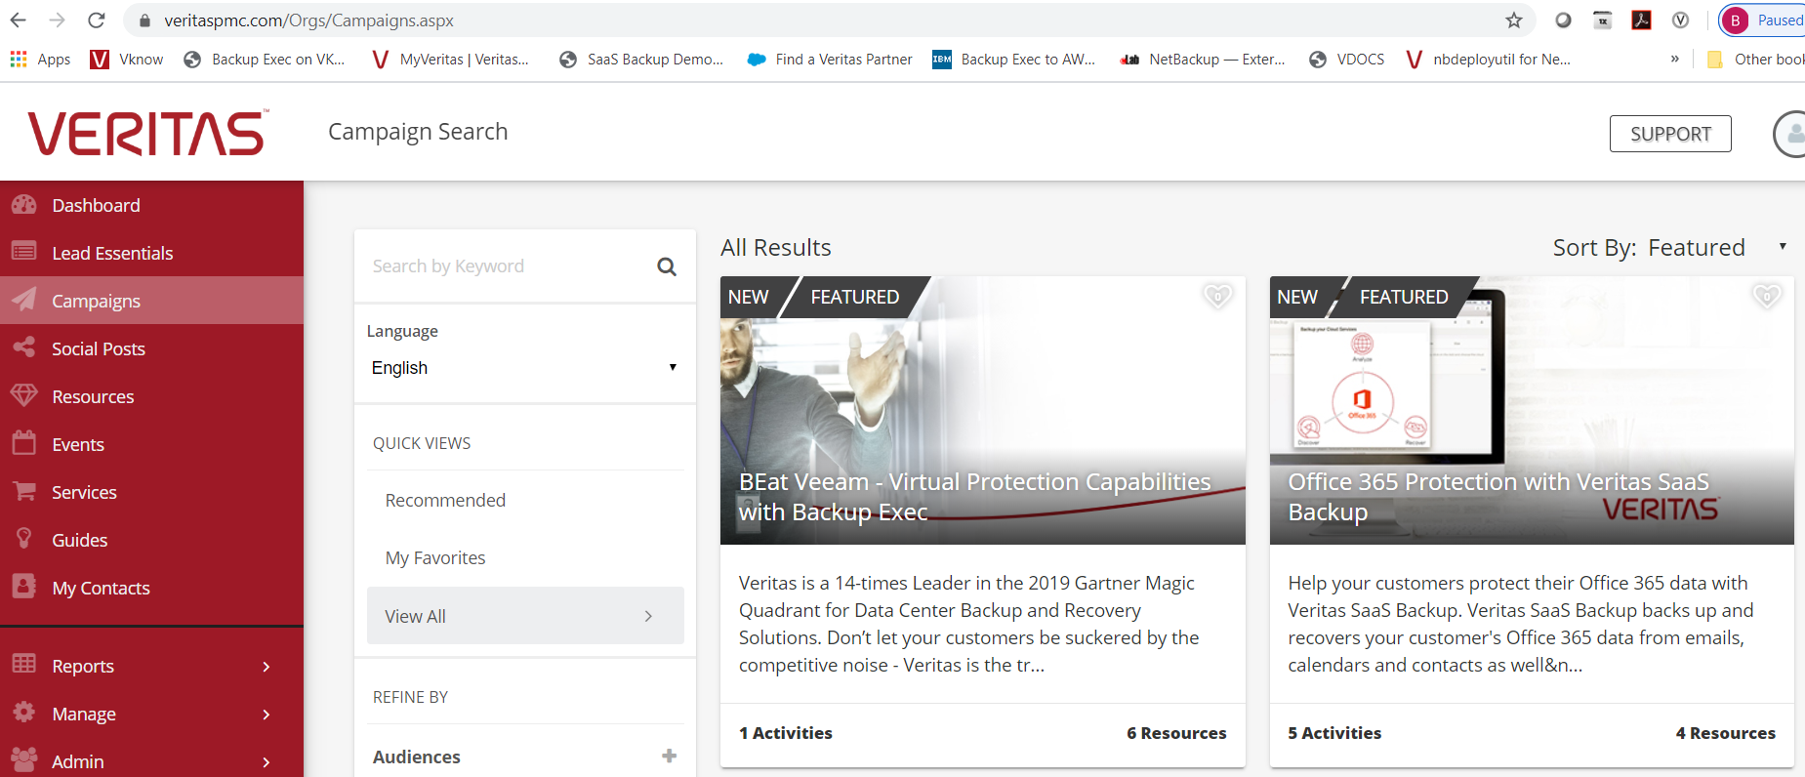
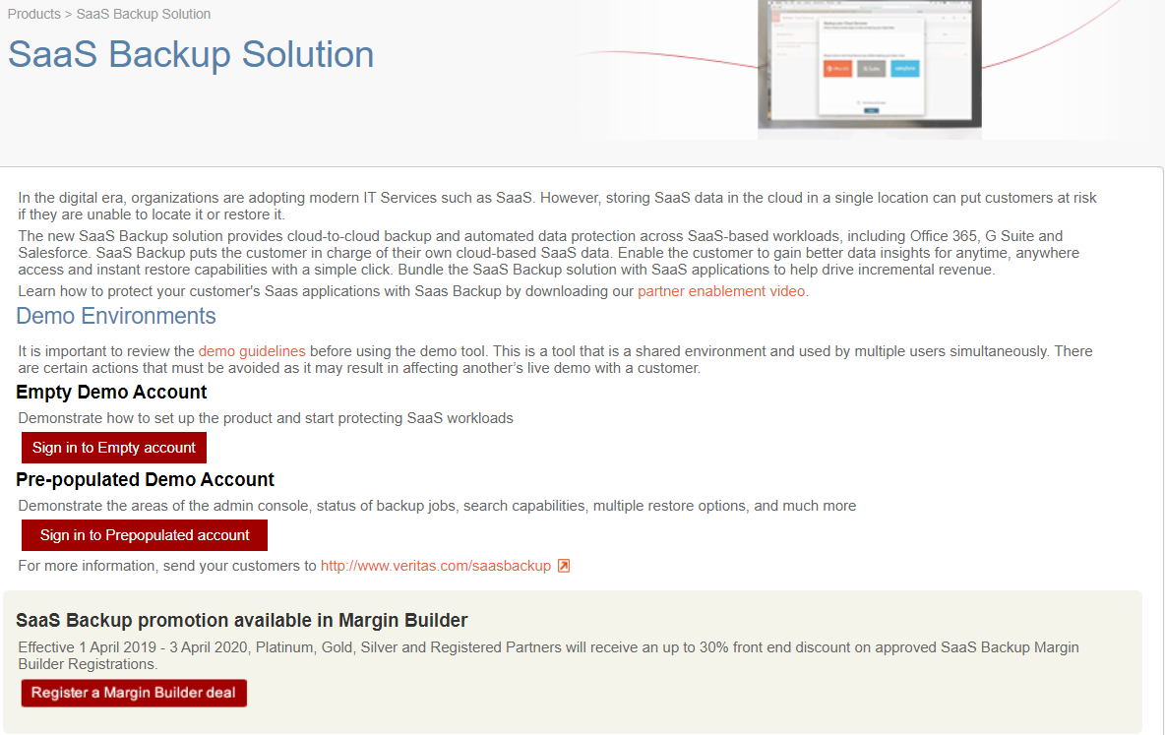
Partner Resources
Partner Marketing Center (PMC)
PartnerNet
Notes:
Mention there is a misconception about SaaS workload data protection: Microsoft is not responsible for Data Classification and offers very limited Data protection capabilities.

Slide 25

Backup Exec Promos
Distribution Promo – extended
Competitive Upgrade – valid through FY21
  Bronze, Silver and Gold Perpetual Editions (Per FETB and Per Instance)
  35% off End User Buy Price
  30+% off in Margin Builder
  Competitive Upgrade SKUs - New Customers only
The New Veritas FY21 Margin Builder discount for eligible resellers is:
  10% Registered
  15% Silver
  20% Gold
  25% Platinum (was previously 20% in Veritas FY20)

Slide 26
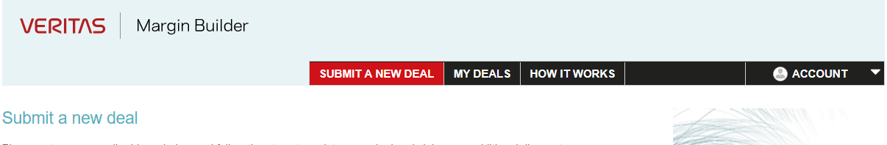
Margin Builder Profit
http://www.veritasmarginbuilder.com/
1
2
3
REGISTER YOUR OPPORTUNITY FOR DEAL PROTECTION
VERITAS VALIDATES YOUR REGISTRATION QUICKLY
RECEIVE YOUR DISCOUNT CODE & APPLY IT TO THE ORDER
UP TO 25% MARGIN ON ANY SIZE ORDER – PAID AS ADDITIONAL DISCOUNT
30%plus on Competitive Promo

Slide 27
Take Action Today
1
Obtain the smart selling tips, datasheet and other assets to help learn
2
Generate leads with prepared marketing campaigns and materials
3
Benefit from additional margin by registering opportunities
4
Expand your cloud opportunity through new and existing Backup Exec customers
5
Increase customer lifetime value with all-inclusive licensing and renewal

Slide 28




Backup Exec Family
Veritas Backup Exec – 60 Day Eval
  https://www.veritas.com/form/trialware/backup-exec
Veritas Backup Exec – Forum
  https://vox.veritas.com/t5/Backup-Exec/bd-p/backup-exec
Veritas Backup Exec – Support
  https://www.veritas.com/content/support/en_US/dpp.BackupExec.html
Veritas SaaS Backup – 30 Day Eval
  https://www.veritas.com/protection/saas-backup
Veritas SaaS Backup – Forum
  https://vox.veritas.com/t5/SaaS-Backup/bd-p/SaaS-Backup
Veritas SaaS Backup – Support
  https://www.veritas.com/content/support/en_US/dpp.SaaSBackup.html
Veritas System Recovery – 60 Day Eval
  https://www.veritas.com/protection/system-recovery
Veritas System Recovery – Forum
  https://vox.veritas.com/t5/System-Recovery/bd-p/system-recovery
Veritas System Recovery – Support
  https://www.veritas.com/content/support/en_US/dpp.SystemRecovery.html
Veritas Desktop and Laptop Option – 60 Day Eval
  https://www.veritas.com/protection/desktop-and-laptop-option
Veritas Desktop and Laptop Option – Forum
  https://vox.veritas.com/t5/System-Recovery/bd-p/system-recovery
Veritas Desktop and Laptop Option – Support
  https://www.veritas.com/content/support/en_US/dpp.DesktopLaptopOption.html

Slide 29
Hyperlinks for BE
BE 20.x Trial: https://www.veritas.com/content/trial/en/us/backup-exec-20
Updates, Patches and Late Breaking News for Backup Exec 20.x
https://www.veritas.com/support/en_US/article.100043266.html#Documentation?q=*&undefined&docRepo=true
Videos
  Backup Exec Virtual Capabilities
    https://www.youtube.com/watch?v=1RKgzyPhFj8
  Backup Exec and the Cloud
    https://www.youtube.com/watch?v=4uThVJd60SU
  Backup Exec Instant Cloud Recovery
    https://www.youtube.com/watch?v=VpSOOBrWdjE
  Backup Exec + SaaS Backup for O365 Workloads
    https://youtu.be/pNVTrlFUvVw
BE Support : https://www.veritas.com/content/support/en_US/BackupExec.html
End of Support for Prior Backup Exec Versions: https://www.veritas.com/support/en_US/article.100038900.html
BE Master Compatibility List: https://www.veritas.com/support/en_US/article.000017788
Backup Exec 20.5 Tuning and Performance Guide
https://www.veritas.com/content/support/en_US/doc/40056030-139024710-1
Configuring S3-Compatible Cloud Storage for use with Backup Exec
https://www.veritas.com/content/support/en_US/article.100039077.html

Slide 30
Thank You

